Slide 1
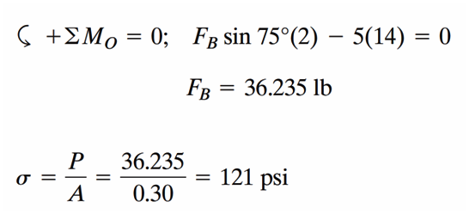
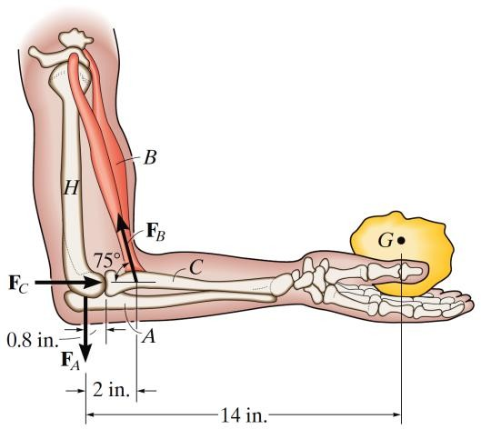
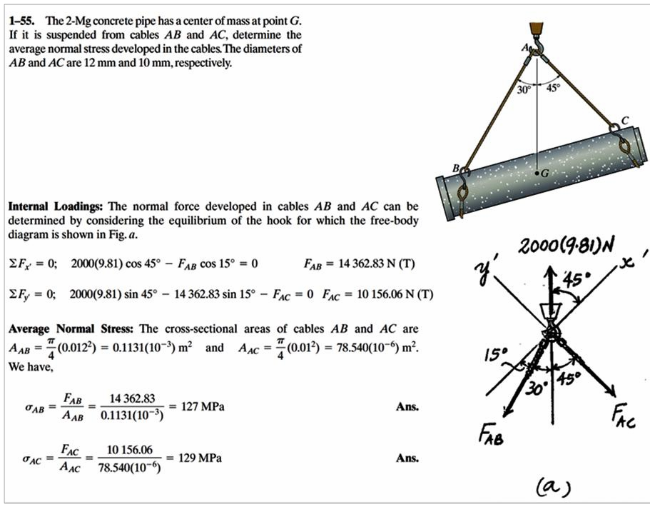
Example
H.W
When the hand is holding the 5-lb stone, the humerus H, assumed to be smooth, exerts normal forces F_{C} and F_{A} on the radius C and ulna A, respectively, as shown. If the smallest cross-sectional area of the ligament at B is 0.30 in², determine the greatest average tensile stress to which it is subjected.
Example

Slide 2
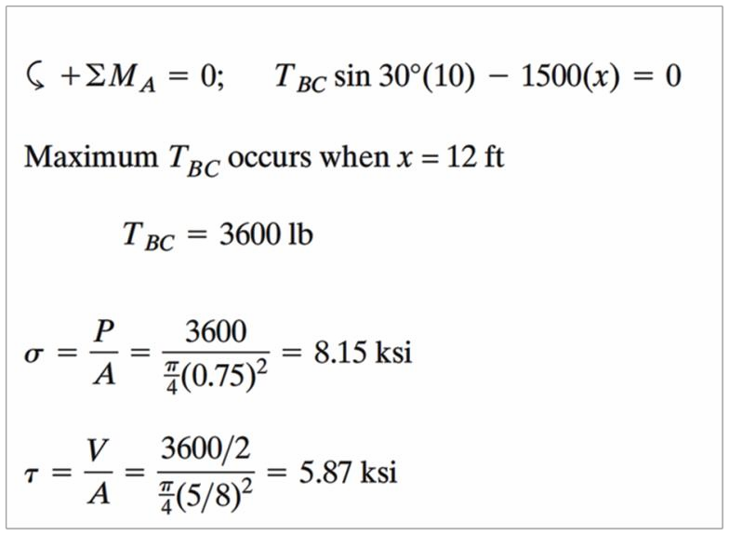
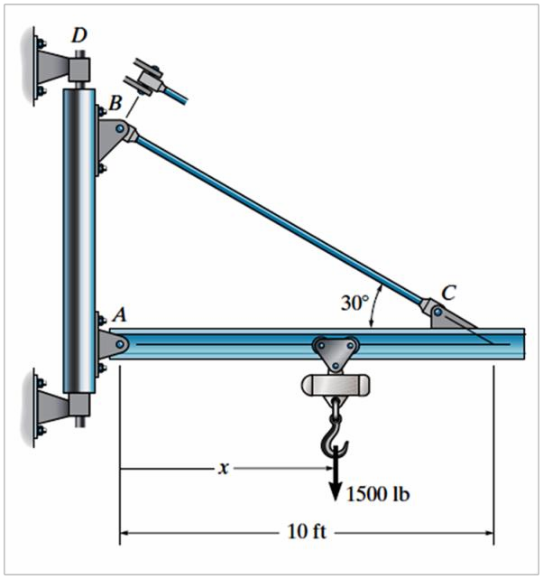
H.W
The jib crane is pinned at A and supports a chain hoist that can travel along the bottom
flange of the beam, 1𝑓𝑡 ≤ 𝑥 ≤ 12𝑓𝑡 If the hoist is rated to support a maximum of 1500 lb, determine the maximum average normal stress in the -in. diameter tie rod BC and the maximum average shear stress in the -in. -diameter pin at B.

Slide 3
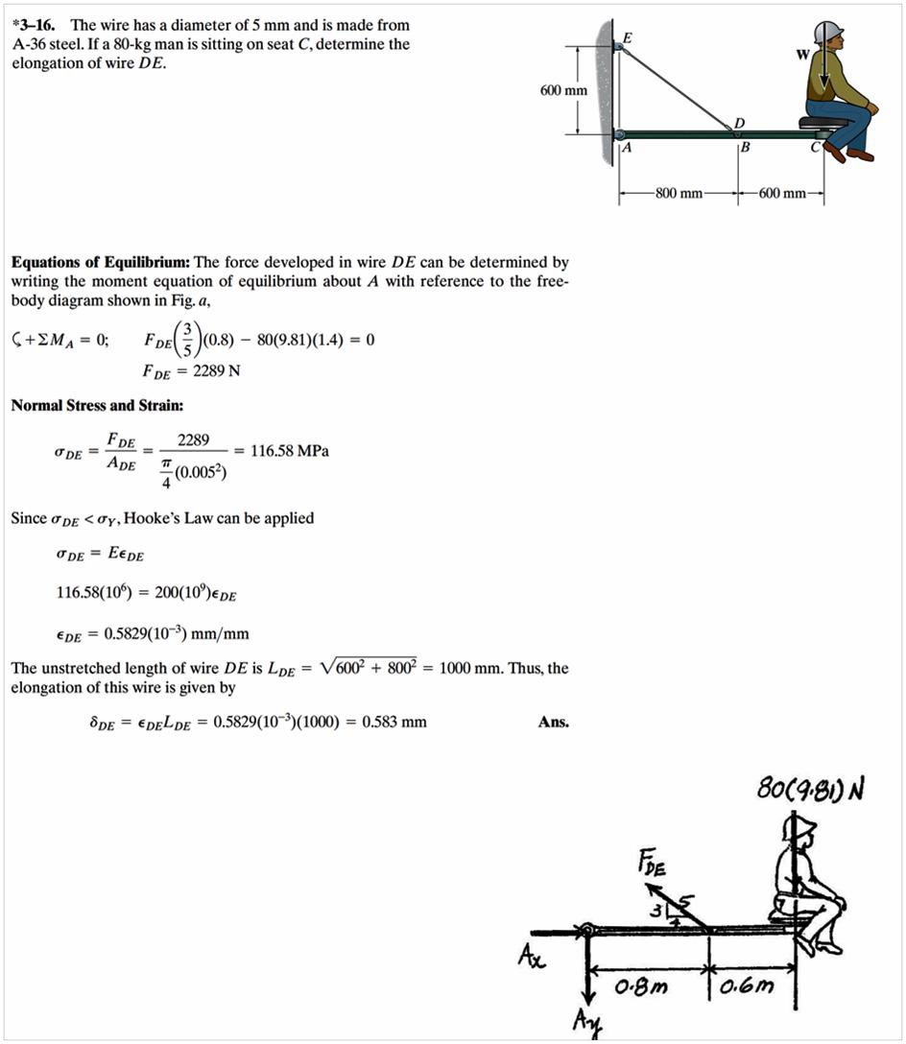
Example

Slide 4
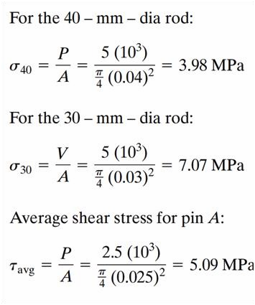
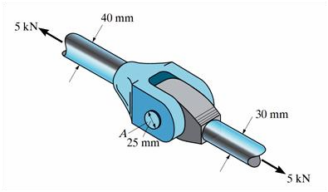
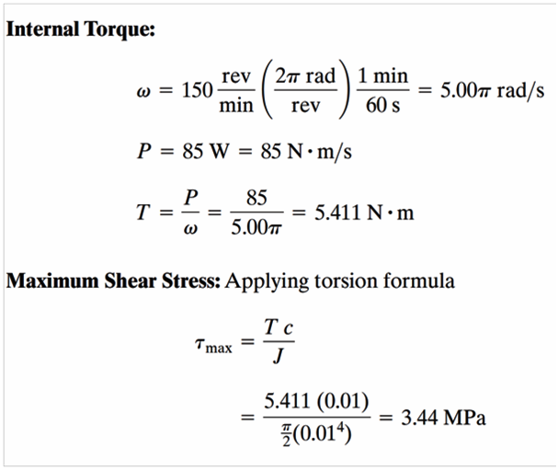
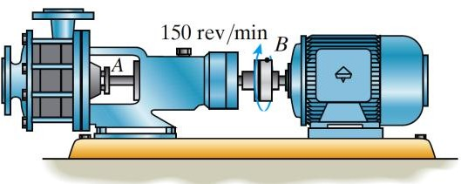
H.W
The yoke-and-rod connection is subjected to a tensile force of 5 kN. Determine the average normal stress in each rod and the average shear stress in the pin A between the members.
Example
The pump operates using the motor that has a power of 85 W. If the impeller at B is turning at 150rev/min determine the maximum shear stress developed in the 20-mm- diameter transmission shaft at A.

